Slide 1
18-447 MIPS ISA
James C. Hoe
Dept of ECE, CMU

Slide 2
Instruction Set Architecture
A stable platform, typically 15~20 years
  guarantees binary compatibility for SW investments
  permits adoption of foreseeable technology advances
User-level ISA
  program visible state and instructions available to user processes
  single-user abstraction on top of HW/SW virtualization
“Virtual Environment” Architecture
  state and instructions to control virtualization (e.g., caches, sharing)
  user-level, but not used by your average user programs
“Operating Environment” Architecture
  state and instructions to implement virtualization
  privileged/protected access reserved for OS

Slide 3
Terminologies
Instruction Set Architecture
  the machine behavior as observable and controllable by the programmer
Instruction Set
  the set of commands understood by the computer
Machine Code
  a collection of instructions encoded in binary format
  directly consumable by the hardware
Assembly Code
  a collection of instructions expressed in “textual” format e.g. Add r1, r2, r3
  converted to machine code by an assembler
  one-to-one correspondence with machine code
  (mostly true: compound instructions, address labels ....)

Slide 4
What are specified/decided in an ISA?
Data format and size
  character, binary, decimal, floating point, negatives
“Programmer Visible State”
  memory, registers, program counters, etc.
Instructions: how to transform the programmer visible state?
  what to perform and what to perform next
  where are the operands
Instruction-to-binary encoding
How to interface with the outside world?
Protection and privileged operations
Software conventions
Very often you compromise immediate optimality for future scalability and compatibility

Slide 5
MIPS R2000 Program Visible State
Program Counter
32-bit memory address
of the current instruction
**Note** r0=0
General Purpose
Register File
32 32-bit words
named r0...r31
r1
r2
M[0]
M[1]
M[2]
M[3]
M[4]
Memory
2³² by 8-bit locations (4 Giga Bytes)
32-bit address
(there is some magic going on)
M[N-1]

Slide 6
Data Format
Most things are 32 bits
  instruction and data addresses
  signed and unsigned integers
  just bits
Also 16-bit word and 8-bit word (aka byte)
Floating-point numbers
  IEEE standard 754
  float: 8-bit exponent, 23-bit significand
  double: 11-bit exponent, 52-bit significand

Slide 7
Big Endian vs. Little Endian
(Part I, Chapter 4, Gulliver’s Travels)
32-bit signed or unsigned integer comprises 4 bytes
On a byte-addressable machine . . . . . . .
Big Endian Little Endian
What difference does it make?
MSB
(most significant)
LSB
(least significant)
8-bit
8-bit
8-bit
8-bit
MSB
LSB
MSB
LSB
byte 0
byte 1
byte 2
byte 3
byte 3
byte 2
byte 1
byte 0
byte 4
byte 5
byte 6
byte 7
byte 7
byte 6
byte 5
byte 4
byte 8
byte 9
byte 10
byte 11
byte 11
byte 10
byte 9
byte 8
byte 12
byte 13
byte 14
byte 15
byte 15
byte 14
byte 13
byte 12
byte 16
byte 17
byte 18
byte 19
byte 19
byte 18
byte 17
byte 16
pointer points to the big end
pointer points to the little end
check out htonl(), ntohl() in in.h

Slide 8
Instruction Formats
3 simple formats
  R-type, 3 register operands
  I-type, 2 register operands and 16-bit immediate operand
  J-type, 26-bit immediate operand
Simple Decoding
  4 bytes per instruction, regardless of format
  must be 4-byte aligned (2 lsb of PC must be 2b’00)
  format and fields readily extractable
0
6-bit
rs
5-bit
rt
5-bit
rd
5-bit
shamt
5-bit
funct
6-bit
R-type
opcode
6-bit
rs
5-bit
rt
5-bit
immediate
16-bit
I-type
opcode
6-bit
immediate
26-bit
J-type

Slide 9
ALU Instructions
Assembly (e.g., register-register signed addition)
ADD rd_{reg} rs_{reg} rt_{reg}
Machine encoding
Semantics
  GPR[rd] ← GPR[rs] + GPR[rt]
  PC ← PC + 4
Exception on “overflow”
Variations
  Arithmetic: {signed, unsigned} x {ADD, SUB}
  Logical: {AND, OR, XOR, NOR}
  Shift: {Left, Right-Logical, Right-Arithmetic}
0
6-bit
rs
5-bit
rt
5-bit
rd
5-bit
0
5-bit
ADD
6-bit
R-type

Slide 10
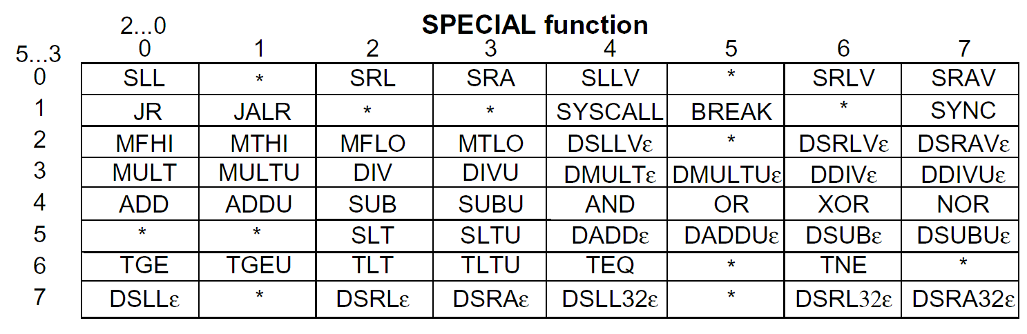
Reg-Reg Instruction Encoding
[MIPS R4000 Microprocessor User’s Manual]
What patterns do you see? Why are they there?

Slide 11
ALU Instructions
Assembly (e.g., regi-immediate signed additions)
ADDI rt_{reg} rs_{reg} immediate₁₆
Machine encoding
Semantics
  GPR[rt] ← GPR[rs] + sign-extend (immediate)
  PC ← PC + 4
Exception on “overflow”
Variations
  Arithmetic: {signed, unsigned} x {ADD, SUB}
  Logical: {AND, OR, XOR, LUI}
ADDI
6-bit
rs
5-bit
rt
5-bit
immediate
16-bit
I-type

Slide 12
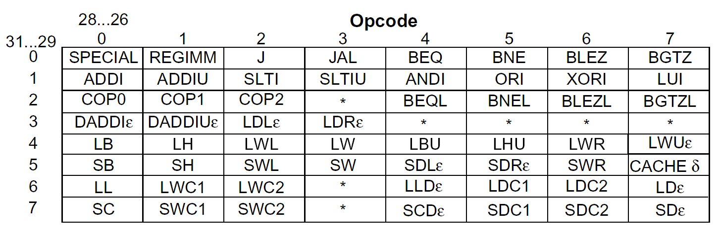
Reg-Immed Instruction Encoding
[MIPS R4000 Microprocessor User’s Manual]

Slide 13
Assembly Programming 101
Break down high-level program constructs into a sequence of elemental operations
E.g. High-level Code
  f = ( g + h ) – ( i + j )
Assembly Code
  suppose f, g, h, i, j are in r_{f}, r_{g}, r_{h}, r_{i}, r_{j}
  suppose r_{temp} is a free register
  add r_{temp} r_{g} r_{h} # r_{temp} = g+h
  add r_{f} r_{i} r_{j} # r_{f} = i+j
  sub r_{f} r_{temp} r_{f} # f = r_{temp} – r_{f}

Slide 14
Load Instructions
Assembly (e.g., load 4-byte word)
LW rt_{reg} offset₁₆ (base_{reg})
Machine encoding
Semantics
  effective_address = sign-extend(offset) + GPR[base]
  GPR[rt] ← MEM[ translate(effective_address) ]
  PC ← PC + 4
Exceptions
  address must be “word-aligned”
  What if you want to load an unaligned word?
  MMU exceptions
I-type
LW
6-bit
base
5-bit
rt
5-bit
offset
16-bit

Slide 15
Data Alignment
MSB
byte-3
byte-2
byte-1
byte-0
LSB
byte-7
byte-6
byte-5
byte-4
LW/SW alignment restriction
  not optimized to fetch memory bytes not within a word boundary
  not optimized to rotate unaligned bytes into registers
Provide separate opcodes for the infrequent case
  LWL rd 6(r0)
  LWR rd 3(r0)
  LWL/LWR is slower but it is okay
  note LWL and LWR still fetch within word boundary
A
B
C
D
byte-6
byte-5
byte-4
D
byte-6
byte-5
byte-4
byte-3

Slide 16
Store Instructions
Assembly (e.g., store 4-byte word)
SW rt_{reg} offset₁₆ (base_{reg})
Machine encoding
Semantics
  effective_address = sign-extend(offset) + GPR[base]
  MEM[ translate(effective_address) ] ← GPR[rt]
  PC ← PC + 4
Exceptions
  address must be “word-aligned”
  MMU exceptions
SW
6-bit
base
5-bit
rt
5-bit
offset
16-bit
I-type

Slide 17
Assembly Programming 201
E.g. High-level Code
  A[ 8 ] = h + A[ 0 ]
  where A is an array of integers (4–byte each)
Assembly Code
  suppose &A, h are in r_{A}, r_{h}
  suppose r_{temp} is a free register
  LW r_{temp} 0(r_{A}) # r_{temp} = A[0]
  add r_{temp} r_{h} r_{temp} # r_{temp} = h + A[0]
  SW r_{temp} 32(r_{A}) # A[8] = r_{temp}
  # note A[8] is 32 bytes # from A[0]

Slide 18
Load Delay Slots
LW ra ---
addi r- ra r-
addi r- ra r-
R2000 load has an architectural latency of 1 inst*.
  the instruction immediately following a load (in the “delay slot”) still sees the old register value
  the load instruction no longer has an atomic semantics
  Why would you do it this way?
Is this a good idea? (hint: R4000 redefined LW to complete atomically)
*BTW, notice that latency is defined in “instructions” not cyc. or sec.

Slide 19
Control Flow Instructions
Assembly Code
(linearized)
Control Flow Graph
C-Code
  { code A }
  if X==Y then
  { code B }
  else
  { code C }
  { code D }
code A
if X==Y
code A
if X==Y
goto
True
False
code B
code C
goto
code C
code B
code D
code D
these things are called basic blocks

Slide 20
(Conditional) Branch Instructions
Assembly (e.g., branch if equal)
BEQ rs_{reg} rt_{reg} immediate₁₆
Machine encoding
Semantics
  target = PC + sign-extend(immediate) x 4
  if GPR[rs]==GPR[rt] then PC ← target
  else PC ← PC + 4
How far can you jump?
Variations
  BEQ, BNE, BLEZ, BGTZ
BEQ
6-bit
rs
5-bit
rt
5-bit
immediate
16-bit
I-type
Why isn’t there a BLE or BGT instruction?

Slide 21
Jump Instructions
Assembly
J immediate₂₆
Machine encoding
Semantics
  target = PC[31:28]x2²⁸ |_{bitwise-or} zero-extend(immediate)x4
  PC ← target
How far can you jump?
Variations
  Jump and Link
  Jump Registers
J
6-bit
immediate
26-bit
J-type

Slide 22
Assembly Programming 301
fork
E.g. High-level Code
  if (i == j) then
  e = g
  else
  e = h
  f = e
Assembly Code
  suppose e, f, g, h, i, j are in r_{e}, r_{f}, r_{g}, r_{h}, r_{i}, r_{j}
  bne r_{i} r_{j} L1 # L1 and L2 are addr labels
  # assembler computes offset
  add r_{e} r_{g} r0 # e = g
  j L2
  L1: add r_{e} r_{h} r0 # e = h
  L2: add r_{f} r_{e} r0 # f = e
  . . . .
then
else
join

Slide 23
Branch Delay Slots
R2000 branch instructions also have an architectural latency of 1 instructions
  the instruction immediately after a branch is always executed (in fact PC-offset is computed from the delay slot instruction)
  branch target takes effect on the 2nd instruction
bne r_{i} r_{j} L1
nop
add r_{e} r_{g} r0
j L2
nop
L1: add r_{e} r_{h} r0
L2: add r_{f} r_{e} r0
. . . .
  bne r_{i} r_{j} L1
  add r_{e} r_{g} r0
  j L2
L1: add r_{e} r_{h} r0
L2: add r_{f} r_{e} r0
  . . . .
bne r_{i} r_{j} L1
nop
j L2
add r_{e} r_{g} r0
L1: add r_{e} r_{h} r0
L2: add r_{f} r_{e} r0
. . . .

Slide 24
Strangeness in the Semantics
Where do you think you will end up?
      _s: j L1
      j L2
      j L3
      L1: j L4
      L2: j L5
      L3: foo
      L4: bar
      L5: baz

Slide 25
Function Call and Return
Jump and Link: JAL offset₂₆
  return address = PC + 8
  target = PC[31:28]x2²⁸ |_{bitwise-or} zero-extend(immediate)x4
  PC ← target
  GPR[r31] ← return address
  On a function call, the callee needs to know where to go back to afterwards
Jump Indirect: JR rs_{reg}
  target = GPR [rs]
  PC ← target
  PC-offset jumps and branches always jump to the same target every time the same instruction is executed
  Jump Indirect allows the same instruction to jump to any location specified by rs (usually r31)

Slide 26
Assembly Programming 401
Caller
... code A ...
JAL _myfxn
... code C ...
JAL _myfxn
... code D ...
Callee
_myfxn: ... code B ...
JR r31
..... A →_{call} B →_{return} C →_{call} B →_{return} D .....
How do you pass argument between caller and callee?
If A set r10 to 1, what is the value of r10 when B returns to C?
What registers can B use?
What happens to r31 if B calls another function

Slide 27
Caller and Callee Saved Registers
Callee-Saved Registers
  Caller says to callee, “The values of these registers should not change when you return to me.”
  Callee says, “If I need to use these registers, I promise to save the old values to memory first and restore them before I return to you.”
Caller-Saved Registers
  Caller says to callee, “If there is anything I care about in these registers, I already saved it myself.”
  Callee says to caller, “Don’t count on them staying the same values after I am done.

Slide 28
R2000 Register Usage Convention
r0: always 0
r1: reserved for the assembler
r2, r3: function return values
r4~r7: function call arguments
r8~r15: “caller-saved” temporaries
r16~r23 “callee-saved” temporaries
r24~r25 “caller-saved” temporaries
r26, r27: reserved for the operating system
r28: global pointer
r29: stack pointer
r30: callee-saved temporaries
r31: return address

Slide 29
R2000 Memory Usage Convention
high address
free space
stack space
grow down
stack pointer
GPR[r29]
grow up
dynamic data
static data
binary executable
text
reserved
low address

Slide 30
Calling Convention
.......
caller saves caller-saved registers
caller loads arguments into r4~r7
caller jumps to callee using JAL
callee allocates space on the stack (dec. stack pointer)
callee saves callee-saved registers to stack (also r4~r7, old r29, r31)
callee loads results to r2, r3
callee restores saved register values
JR r31
caller continues with return values in r2, r3
........
prologue
....... body of callee (can “nest” additional calls) .......
epilogue

Slide 31
To Summarize: MIPS RISC
Simple operations
  2-input, 1-output arithmetic and logical operations
  few alternatives for accomplishing the same thing
Simple data movements
  ALU ops are register-to-register (need a large register file)
  “Load-store” architecture
Simple branches
  limited varieties of branch conditions and targets
Simple instruction encoding
  all instructions encoded in the same number of bits
  only a few formats
Loosely speaking, an ISA intended for compilers rather than assembly programmers

Slide 32
We didn’t talk about
Privileged Modes
  User vs. supervisor
Exception Handling
  trap to supervisor handling routine and back
Virtual Memory
  Each user has 4-GBytes of private, large, linear and fast memory?
Floating-Point Instructions

